Slide 1
Machine Learning: Supervised Learning
Lead: Aishat Sadiq
Support: Jacob Grippen
F23 CCSS DSF

Slide 2
Agenda
Define machine learning
What's the difference?
Supervised v Unsupervised
Applications of Supervised Learning
Regression v Classification v Clustering Problems
Real World Applications
Curse of Dimensionality & Model Fit
Practice running classifying algorithms
Live Coding: Prep
Logistic regression, K Nearest Neighbor, Decision Tree

Slide 3
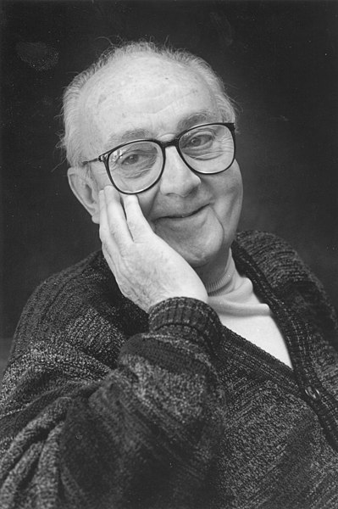
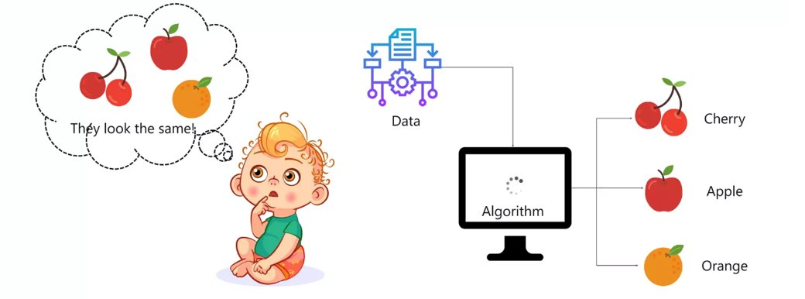
Machine Learning is defined as...
...
Notes:
Literally machines learning through input

Slide 4


How do we learn?
Guidance vs No guidance
Notes:
Child learning example
A child looks through photographs. There are pictures of fruit. The child makes three stacks of photos, organized by how they look
VS
A child points at an apple and its parent points and says “apple." The child then repeats “apple."
Supervised Learning
Learn a rule for predicting the value of an outcome/response variable based on the value of some set of predictor variables.
Have a set of “training” samples for which the predictors and outcome values are known for each data point.
Examples: Linear Regression, Logistic Regression, k-Nearest Neighbor (kNN), Support vector machine (SVM), Random Forest, Naive Bayes (NB)
Unsupervised Learning
the outcome variable is unknown for the training data
E.g., Dimensionality Reduction:
Principal Component Analysis, Linear Discriminant Reduction, Factor Analysis
Non-Linear Discriminant Reduction, Autoencoders, matrix completion/mice, Backward Feature Elimination,
Clustering: K-means, Hierarchical,

Slide 5
How do we teach machines?
Guidance (labeled) vs No guidance (unlabeled)
Notes:
Popular classifiers: logistic regression, Poisson regression, linear discriminant analysis, quadratic discriminant analysis, naive Bayes, and KNN.
Mixed Learning Methods: Zero-Shot Classification: Zero-shot methods generally work by associating observed and non-observed classes through some form of auxiliary information, which encodes observable distinguishing properties of objects. For example, given a set of images of animals to be classified, along with auxiliary textual descriptions of what animals look like, an artificial intelligence model which has been trained to recognize horses, but has never been given a zebra, can still recognize a zebra when it also knows that zebras look like striped horses. This problem is widely studied in computer vision, natural language processing, and machine perception.

Slide 6
Machine Learning Algorithms
What About Mixed Learning Algorithms?
Liew, C. Y., Lim, Y. C., & Yap, C. W. (2011). Mixed learning algorithms and features ensemble in hepatotoxicity prediction. Journal of computer-aided molecular design, 25(9), 855–871. https://doi.org/10.1007/s10822-011-9468-3
Supervised Learning
Examples: Linear Regression, Logistic Regression, KNN, SVM, Random Forest
Unsupervised Learning
Examples: PCA, Clustering

Slide 7
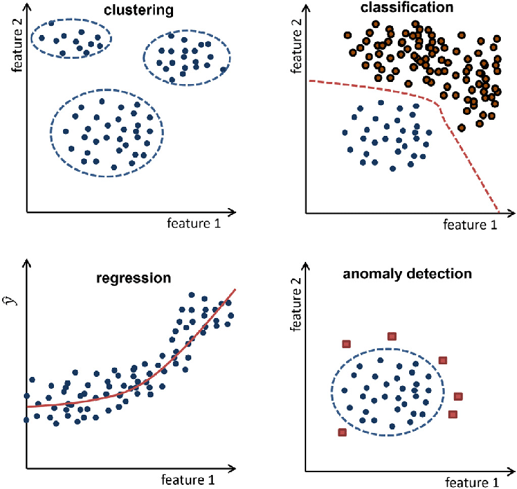
What kind of problems can we solve?
Regression
Predict the value of an observation, given certain data
Classification
Predicting unordered qualitative responses for observations (eg. Recommendation)
Clustering
What categories exist?
Same as classification
Unsupervised Learning
Anomaly Detection
(eg. Noise reduction, time series analysis, multiple imputation for missing values)
Notes:
Predicting classification a qualitative response for an observation can be referred to as classifying that observation, since it involves assigning the observation to a category, or class.
Classification techniques: Logistic Regression, Linear Discriminant Analysis, K-Nearest Neighbor, Support Vector Machines, Tree-based Methods

Slide 8
Discussion Q: 3 Real World Applications of Classification Algorithms 10 minutes
Notes:
1. **Email Spam Filtering:**
- Application: Classifying emails as spam or not spam.
- How it works: The algorithm is trained on a dataset of labeled emails, learning patterns that distinguish between spam and non-spam messages.
2. **Handwriting Recognition:**
- Application: Converting handwritten text into digital text.
- How it works: The algorithm is trained on labeled datasets of handwritten characters to recognize patterns and accurately transcribe them.
3. **Credit Scoring:**
- Application: Predicting the likelihood of a customer defaulting on a loan.
- How it works: Historical data on customers' credit behavior is used to train a model that predicts the creditworthiness of new applicants.
4. **Image Recognition:**
- Application: Identifying objects or faces in images.
- How it works: The algorithm is trained on a dataset of labeled images, learning to recognize specific features that distinguish different objects or faces.
5. **Speech Recognition:**
- Application: Converting spoken language into text.
- How it works: The algorithm is trained on a dataset of audio recordings with corresponding transcriptions, learning to recognize speech patterns and convert them into text.
6. **Medical Diagnosis:**
- Application: Predicting diseases based on patient data.
- How it works: The algorithm is trained on medical records with labeled outcomes to assist in diagnosing diseases or predicting the likelihood of certain medical conditions.
7. **Recommendation Systems:**
- Application: Recommending products, movies, or music to users.
- How it works: The algorithm is trained on user preferences and behavior to make personalized recommendations based on similarities with other users.
8. **Autonomous Vehicles:**
- Application: Making decisions for self-driving cars.
- How it works: The algorithm is trained on data from sensors and cameras to recognize and respond to traffic conditions, pedestrians, and other objects on the road.

Slide 9

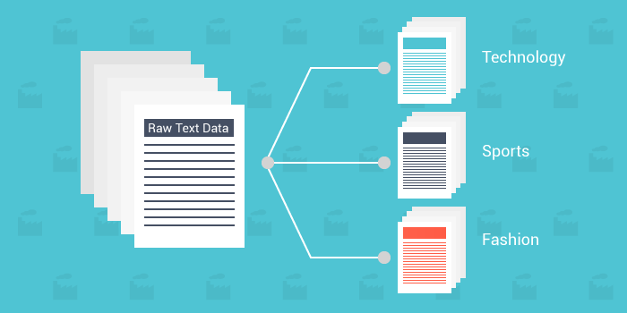
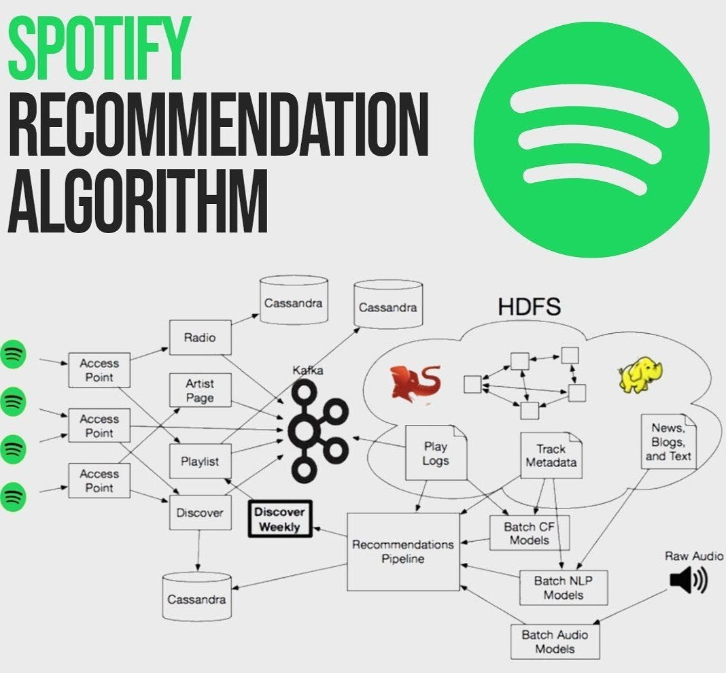
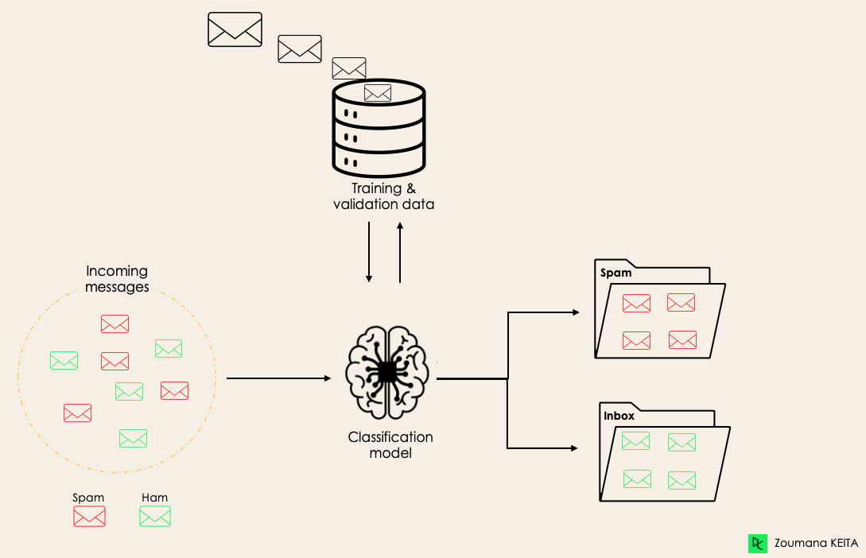
Real World Applications of Classification Algorithms
Notes:
Tesla – Self driving cars
Spotify recommendation
Email filters

Slide 10
Live Coding: Prep Steps
Open RStudio
Install packages
Import dataset
labor_market_discriminiation
dim(), describe()
Notes:
Important to learn your dataset, happens during pre-processing steps.
chrome-extension://efaidnbmnnnibpcajpcglclefindmkaj/https://www.nber.org/system/files/working_papers/w9873/w9873.pdf

Slide 11
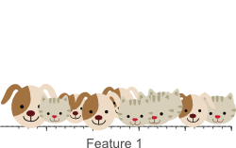
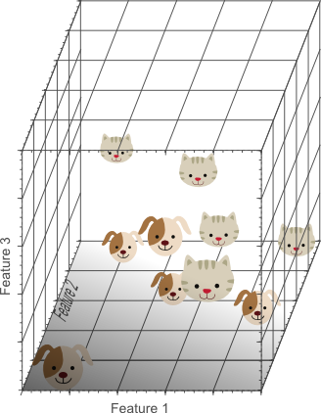
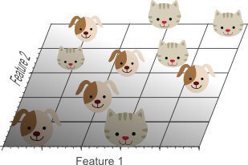
Cat-Dog Classifier Example
Notes:
Consider an example in which we have a set of images, each of which depicts either a cat or a dog. We would like to create a classifier that is able to distinguish dogs from cats automatically. To do so, we first need to think about a descriptor for each object class that can be expressed by numbers, such that a mathematical algorithm, i.e. a classifier, can use these numbers to recognize the object. We could for instance argue that cats and dogs generally differ in color. A possible descriptor that discriminates these two classes could then consist of three number; the average red color, the average green color and the average blue color of the image under consideration. A simple linear classifier for instance, could combine these features linearly to decide on the class label:
However, these three color-describing numbers, called features, will obviously not suffice to obtain a perfect classification. Therefore, we could decide to add some features that describe the texture of the image, for instance by calculating the average edge or gradient intensity in both the X and Y direction. We now have 5 features that, in combination, could possibly be used by a classification algorithm to distinguish cats from dogs.
To obtain an even more accurate classification, we could add more features, based on color or texture histograms, statistical moments, etc. Maybe we can obtain a perfect classification by carefully defining a few hundred of these features? The answer to this question might sound a bit counter-intuitive: no we can not!. In fact, after a certain point, increasing the dimensionality of the problem by adding new features would actually degrade the performance of our classifier. This is illustrated by figure 1, and is often referred to as ‘The Curse of Dimensionality’.

Slide 12
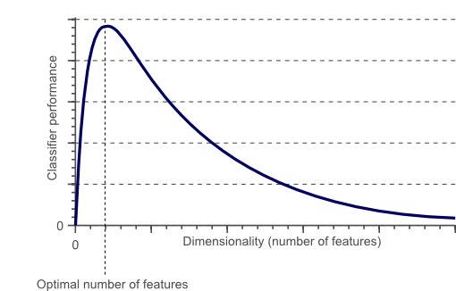
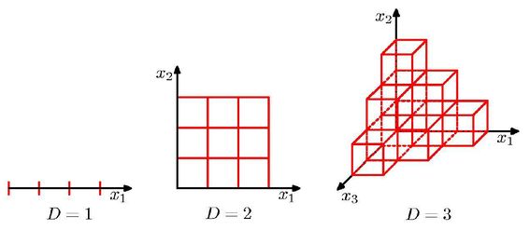
Curse of dimensionality & Overfitting
In order to have a sufficiently accurate model, an enormous amount of training data is required for a large set of features.
With overfitting, the training error will be very low (can even be 0) while test error will be very high. This is because with overfitting, you were able to perfect explain the training data with your model and bias is very low (training error decreases). However, your over-fit model will not be able to explain new data sets well and thus variance will increase (test error increases)
As the dimensionality increases, the classifier’s performance increases until the optimal number of features is reached. Further increasing the dimensionality without increasing the number of training samples results in a decrease in classifier performance.
Notes:
Avoiding curse of dimensionality - Figure 1 showed that the performance of a classifier decreases when the dimensionality of the problem becomes too large. The question then is what ‘too large’ means, and how overfitting can be avoided. Regrettably there is no fixed rule that defines how many feature should be used in a classification problem. In fact, this depends on the amount of training data available, the complexity of the decision boundaries, and the type of classifier used.
If the amount of available training data is fixed, then overfitting occurs if we keep adding dimensions. On the other hand, if we keep adding dimensions, the amount of training data needs to grow exponentially fast to maintain the same coverage and to avoid overfitting.
The more features we use, the more sparse the data becomes such that accurate estimation of the classifier’s parameters (i.e. its decision boundaries) becomes more difficult. Another effect of the curse of dimensionality, is that this sparseness is not uniformly distributed over the search space.

Slide 13
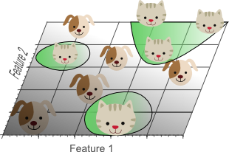
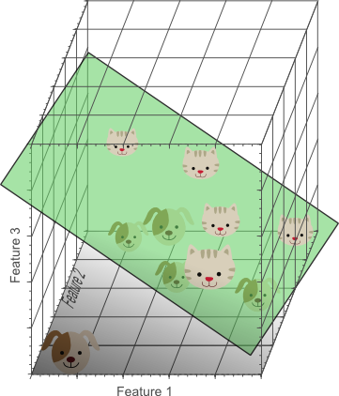
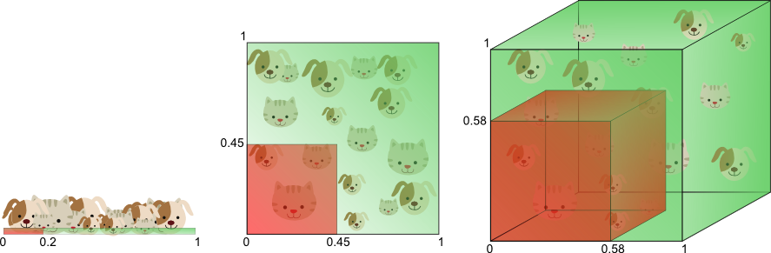
The curse of dimensionality introduces sparseness of the training data
The more features we use, the higher the likelihood that we can successfully separate the classes perfectly.
The amount of training data needed to cover 20% of the feature range grows exponentially with the number of dimensions.
Notes:
If the theoretical infinite number of training samples would be available, the curse of dimensionality does not apply and we could simply use an infinite number of features to obtain perfect classification. The smaller the size of the training data, the less features should be used.
Furthermore, classifiers that tend to model non-linear decision boundaries very accurately (e.g. neural networks, KNN classifiers, decision trees) do not generalize well and are prone to overfitting. Therefore, the dimensionality should be kept relatively low when these classifiers are used. If a classifier is used that generalizes easily (e.g. naive Bayesian, linear classifier), then the number of used features can be higher since the classifier itself is less expressive. Figure 6 showed that using a simple classifier model in a high dimensional space corresponds to using a complex classifier model in a lower dimensional space.
An invaluable technique used to detect and avoid overfitting during classifier training is cross-validation. Cross validation approaches split the original training data into one or more training subsets. During classifier training, one subset is used to test the accuracy and precision of the resulting classifier, while the others are used for parameter estimation. If the classification results on the subsets used for training greatly differ from the results on the subset used for testing, overfitting is in play. Several types of cross-validation such as k-fold cross-validation and leave-one-out cross-validation can be used if only a limited amount of training data is available.

Slide 14
Live Coding Demo
Logistic Regression
Notes:
Uses maximum likelihood instead of least squares
Likelihood function of coin toss. The estimates B0 and B1 are chosen to maximize this likelihood function.

Slide 15
Interpretation: OLS vs Maximum Likelihood
Least Squares Estimation minimizes the sum of squares
Maximum Likelihood Estimation selects the model with the highest likelihood of producing the observed data
If OLS assumptions are met both produce the same estimates
Notes:
Single Logistic Regression Interpretation
X is associated with an increase in the probability of Y. A one-unit increase in X is associated with an increase in the log odds of Y by B1 units.
Multiple logistic Regression Interpretation
K=2 -> Holding X1 + X2 constant, the likelihood of Y1
K>2 -> Multinomial logistic regression - softmax coding

Slide 16
Live Coding Demo
Decision Trees

Slide 17

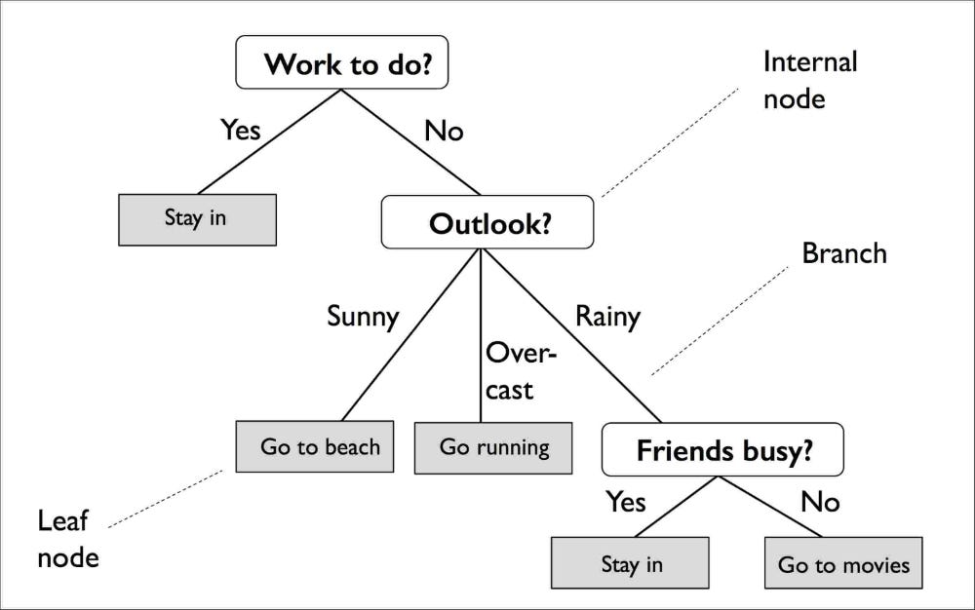
Building Intuition...

Slide 18
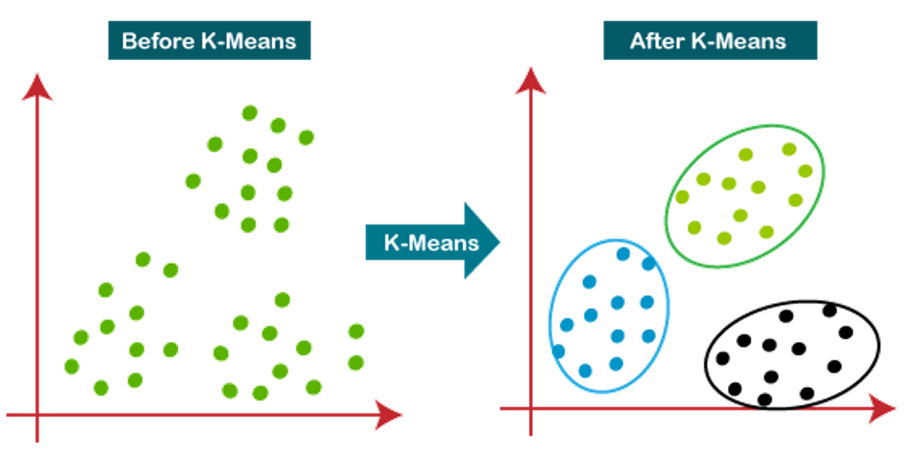
Live Coding Demo: K-Means Clustering
Select # of clusters
Initialize centroids
Assignment to closest cluster
Measuring distance
Recompute w/ cluster mean
Repeat 3&4 until no change or last iteration
What's happening under the hood?
Notes:
Apply Cross-Validation techniques to select the degrees of polynomials in regression

Slide 19
Summary

Slide 20
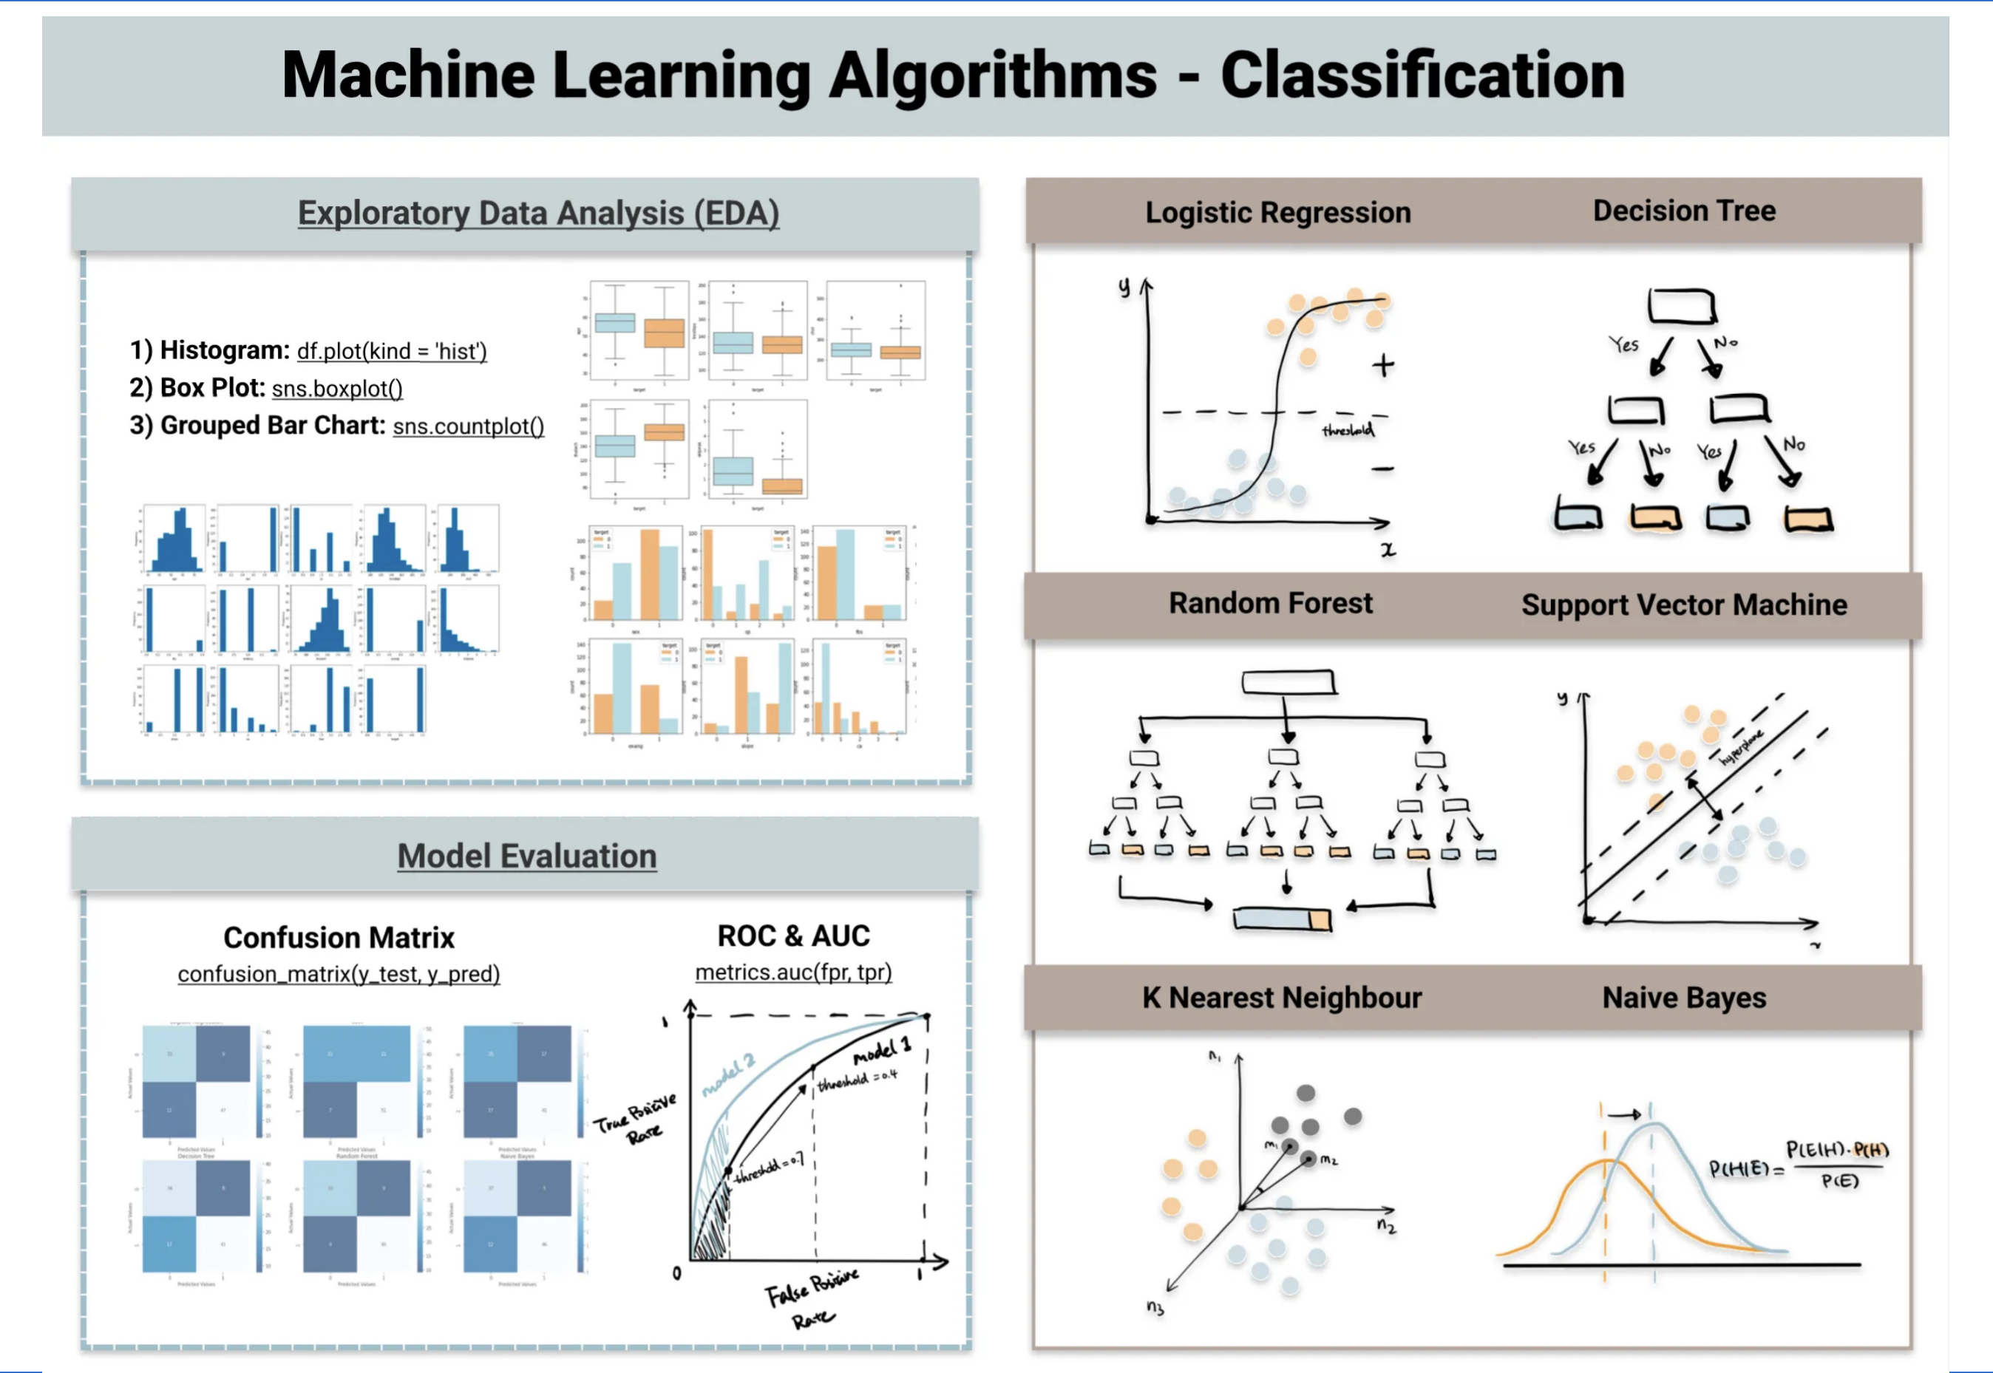
Summary

Slide 21
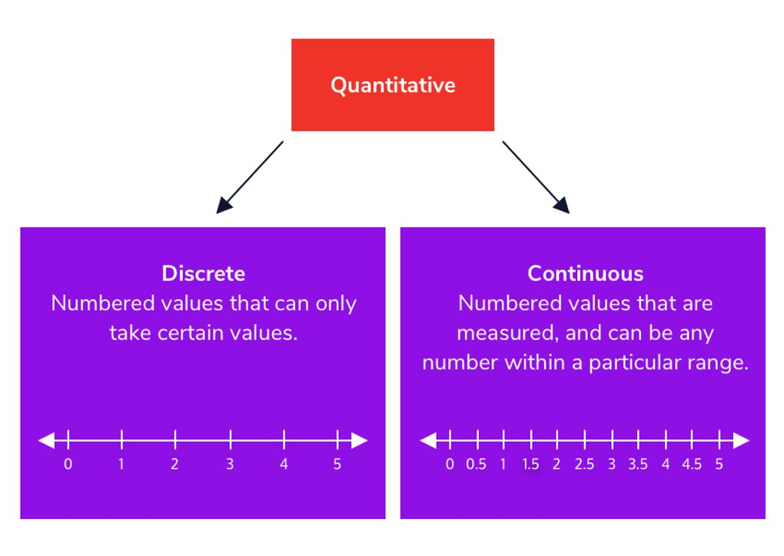
Choose statistical techniques based on your goals and the properties of the data.
Collecting Data
Cleaning Data
Choosing Features
Bias-Variance Tradeoff
Selection v Extraction
Evaluate Model Performance + Error
Iterative process of optimizing parameters
Notes:
Model performance -> Number of Features & feature Selection w/ CV, Feature extraction = dimensionality reduction, Measurng error

Slide 22
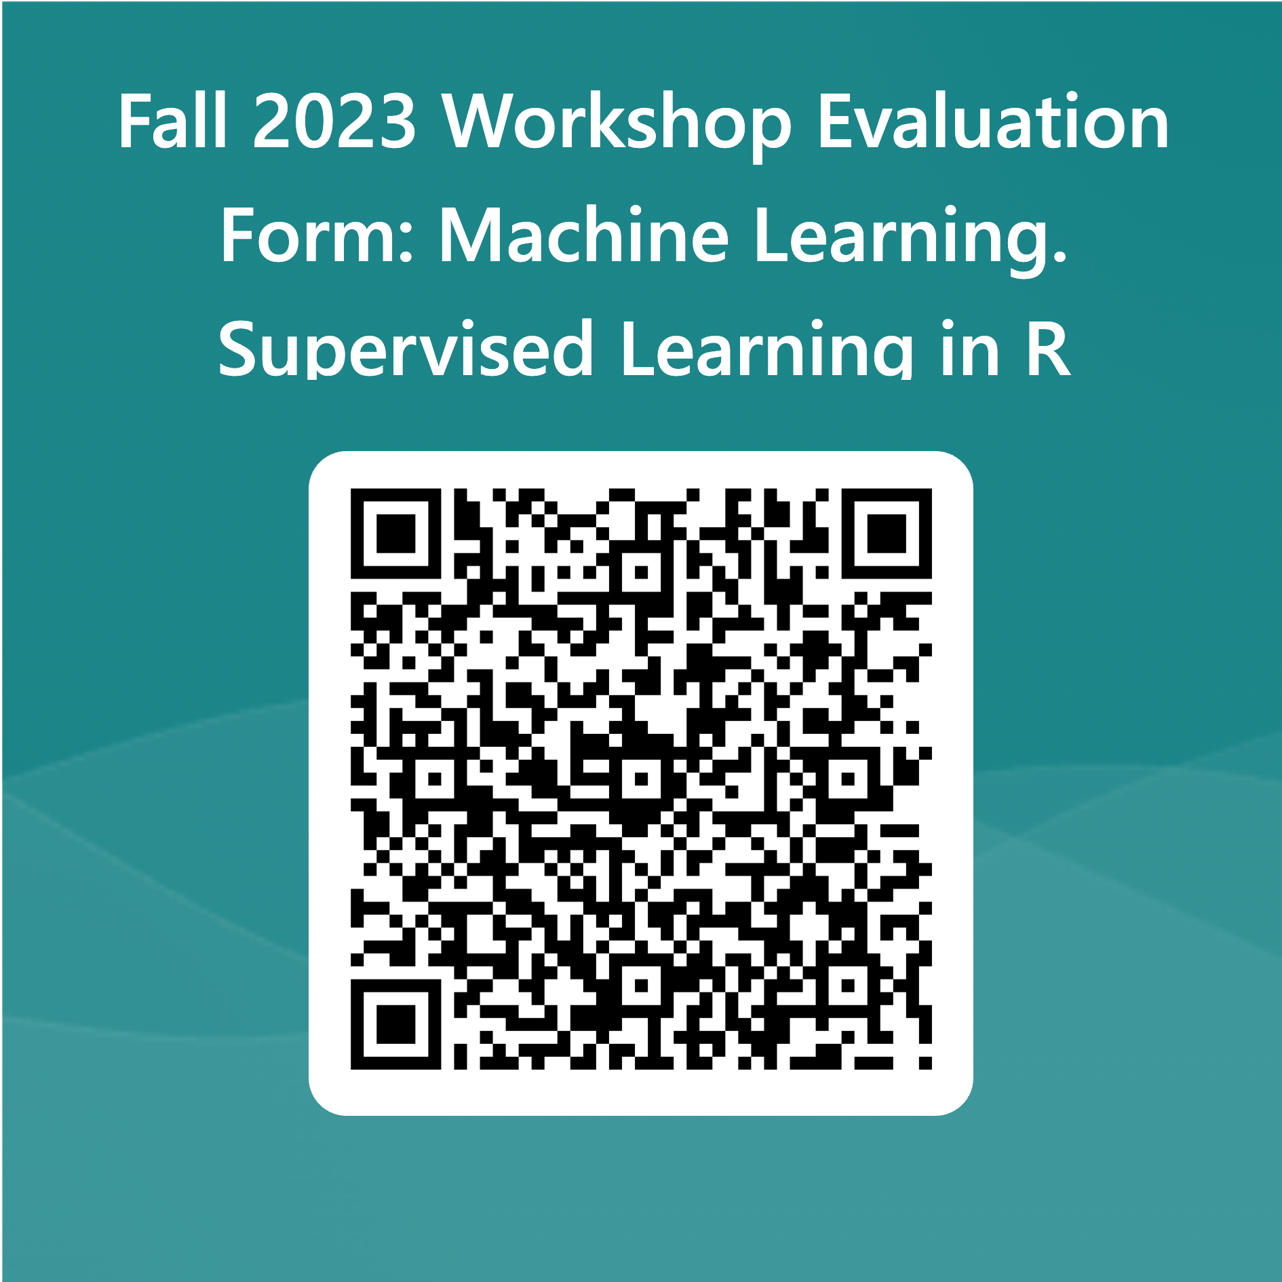

Slide 23
Resources
https://vincentarelbundock.github.io/Rdatasets/index.html
https://www.statlearning.com/
An Introduction to Statistical Learning (R & Python)
Notes:
What we went over is covered in the Classification chapter. If you'd like to get into the math [resource].

Slide 24
What questions do you have?

Slide 25
JUNKYARD

Slide 26
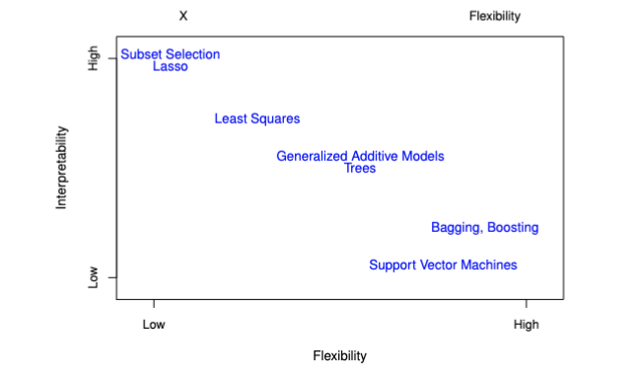
Bias Variance Tradeoff

